Slide 1

DEPENDENCY INJECTION WITH JAVA ANNOTATIONS

Slide 2
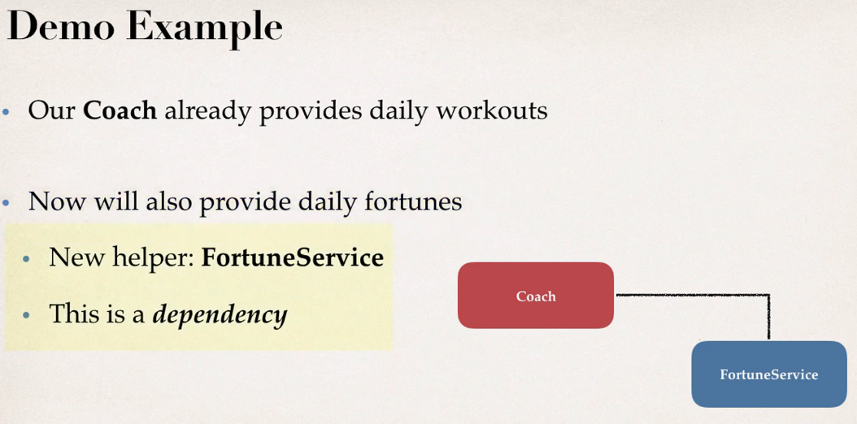
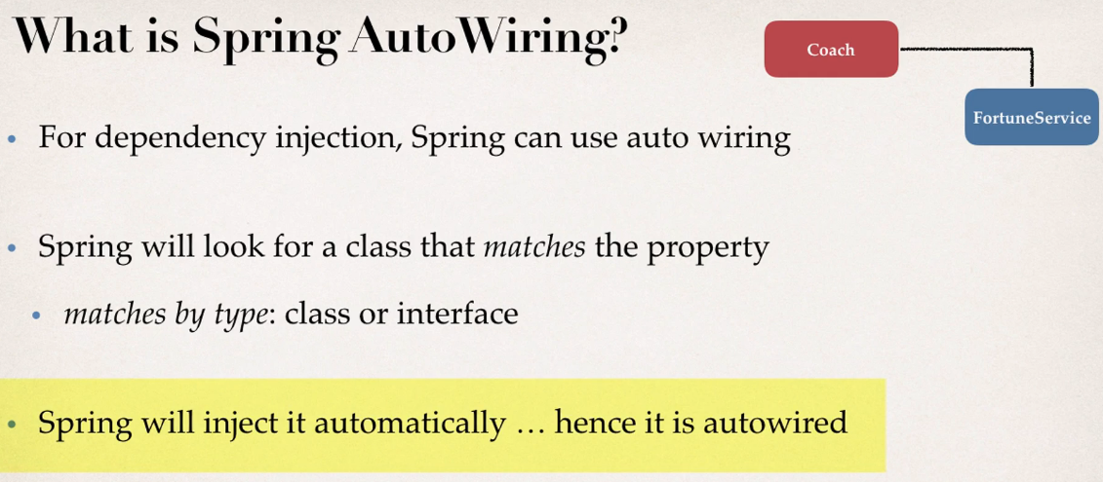
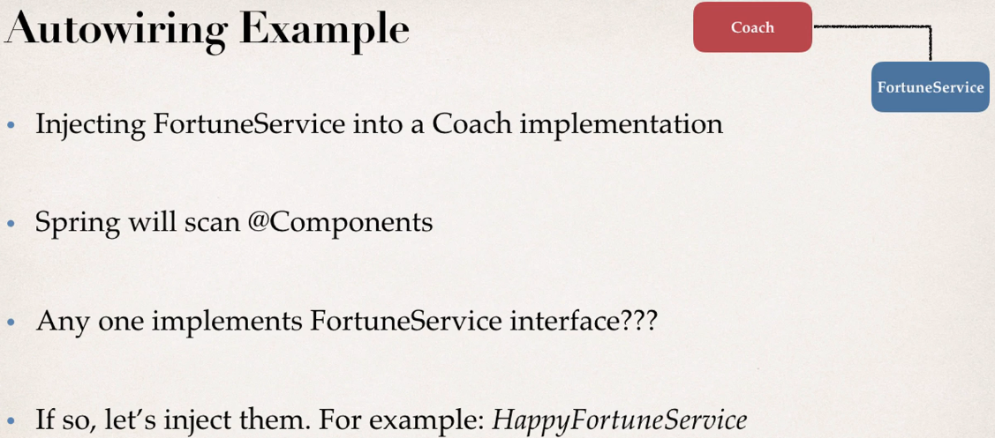
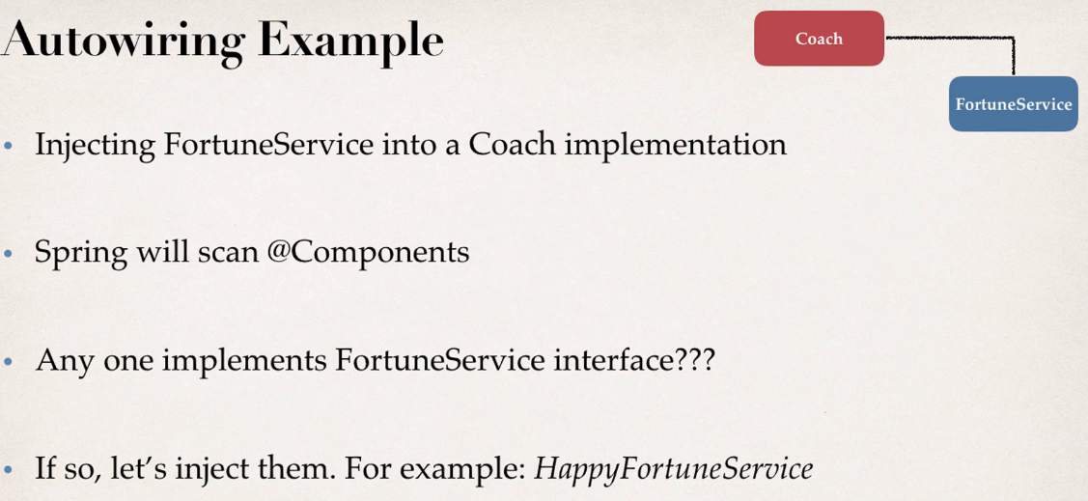
Notes:
We will do the dependency injection on the same example that we have done in dependency injection using XML configuration

Slide 3
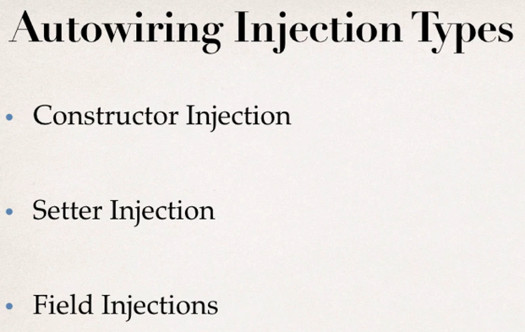
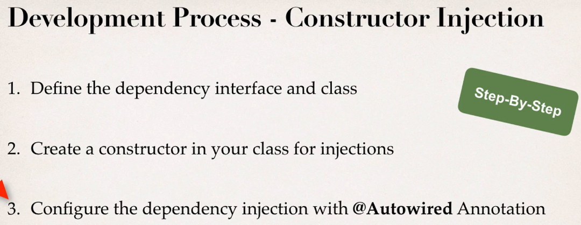
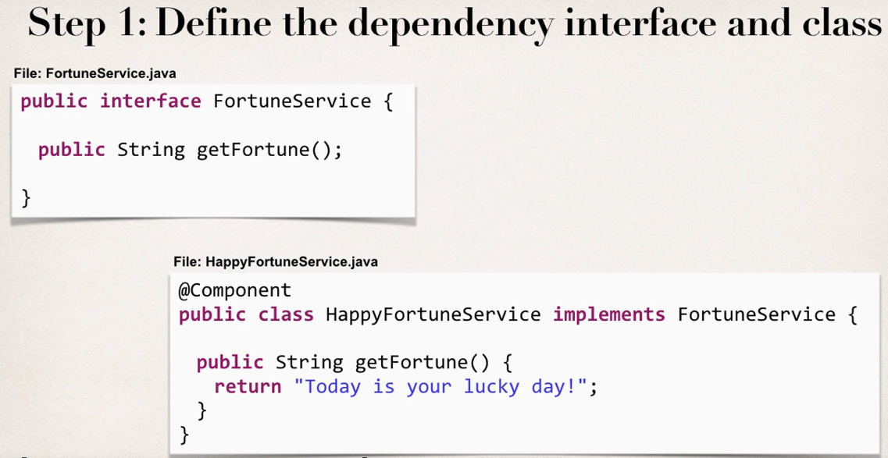
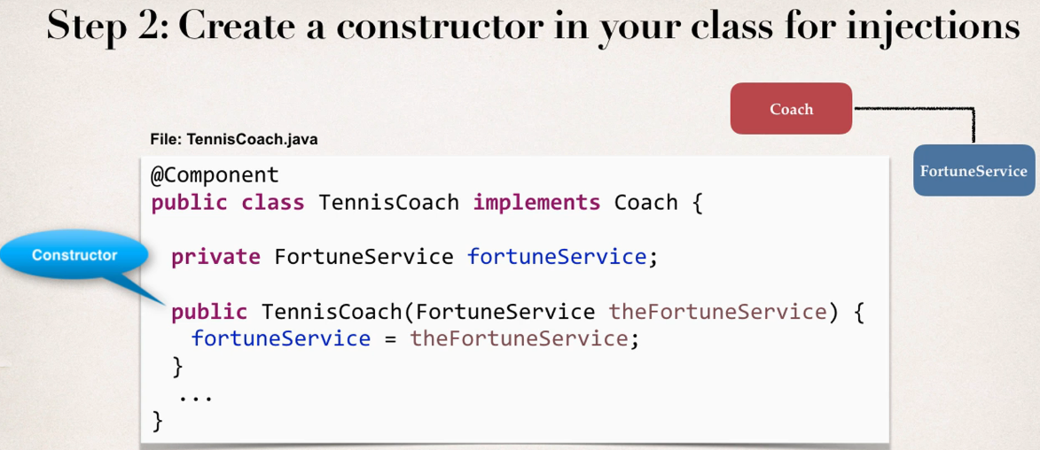
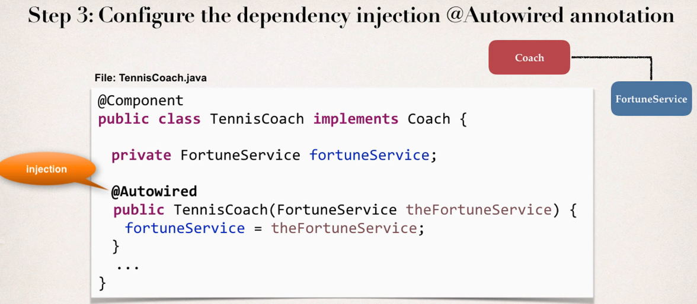

Slide 4
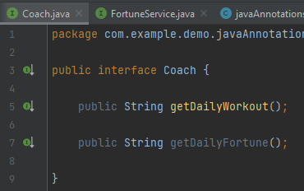
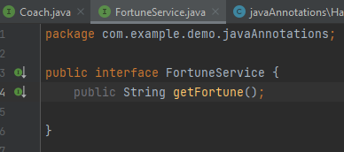
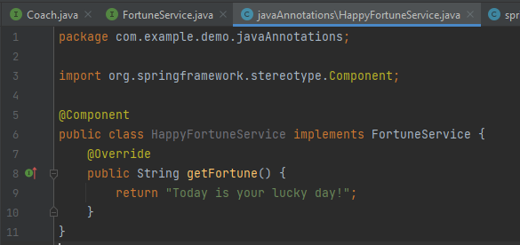
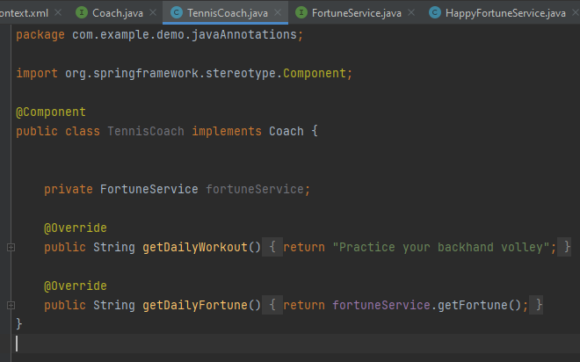
Step -1 Define the dependency interface and class

Slide 5
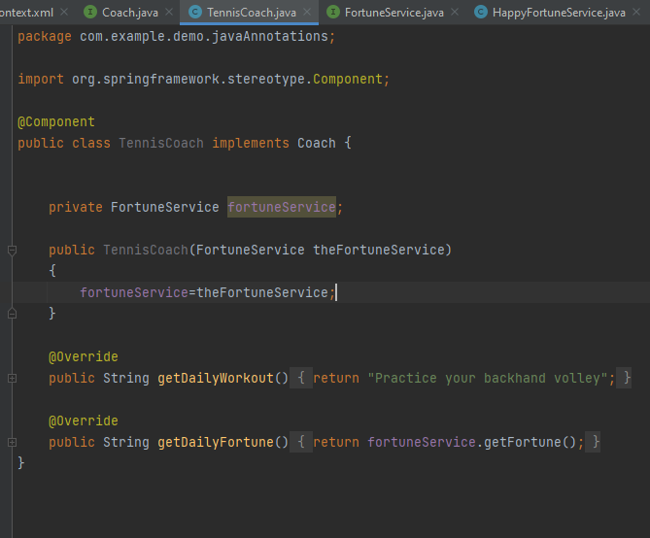
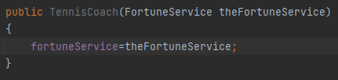
Step -2 Create constructor in your class for injection

Slide 6
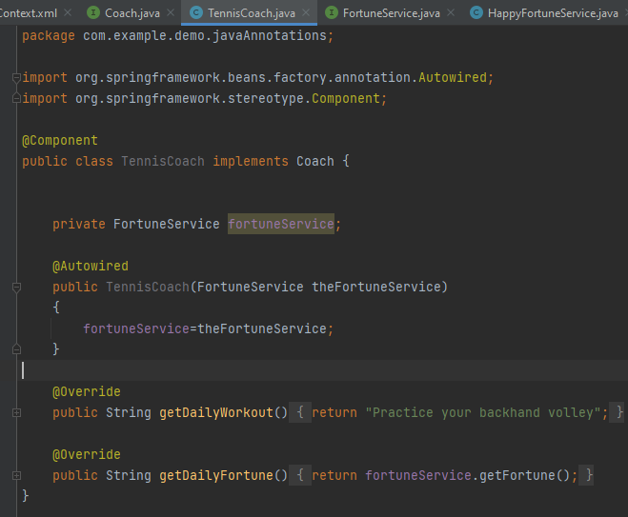
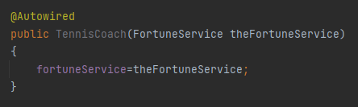

Step -3 Configure dependency injection with @Autowired annotation

Slide 7
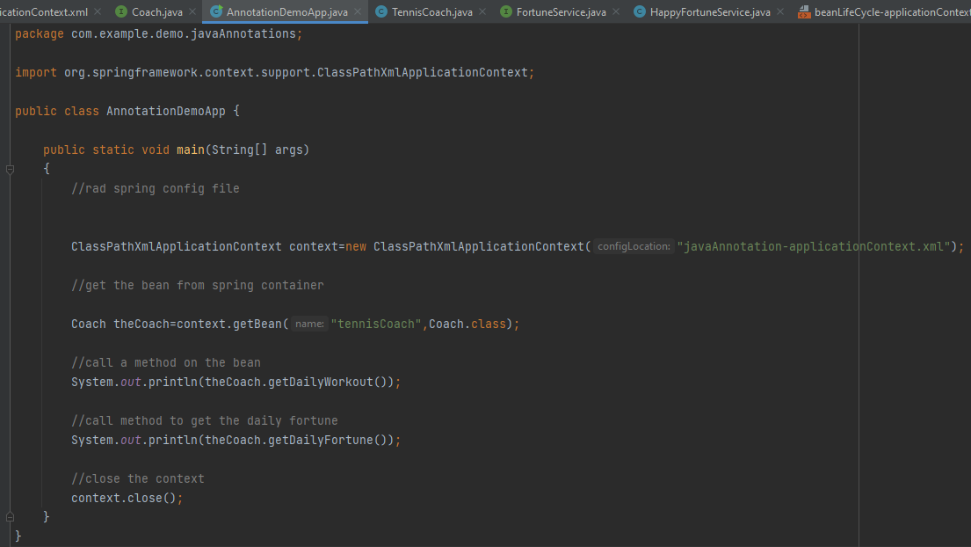
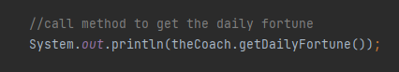
Notes:
I have commented the Autowired annotation. But still it worked. How did it work?
//@Autowired
public TennisCoach(FortuneService theFortuneService) {
System.out.println(" theFortuneService " + theFortuneService);
fortuneService = theFortuneService;
}
Answer
This is a new feature of Spring 4.3.
Here is the snippet from the Spring Docs.
Section 1.9.2: Autowired
As of Spring Framework 4.3, an @Autowired annotation on such a constructor is no longer necessary if the target bean only defines one constructor to begin with. However, if several constructors are available, at least one must be annotated to teach the container which one to use.
I(Instructor) personally prefer to use the @Autowired annotation because it makes the code more readable. But as mentioned, the @Autowired is not required for this scenario.

Slide 8

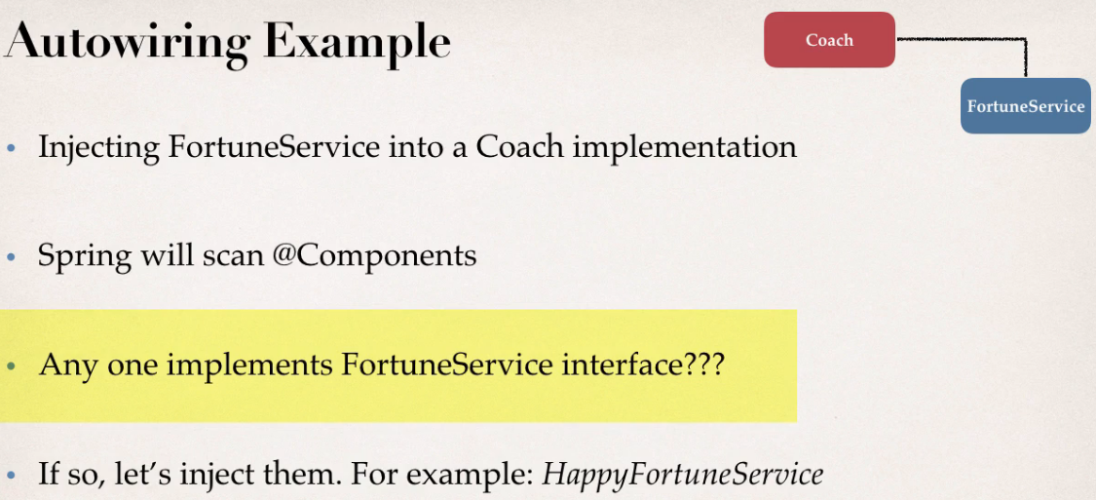
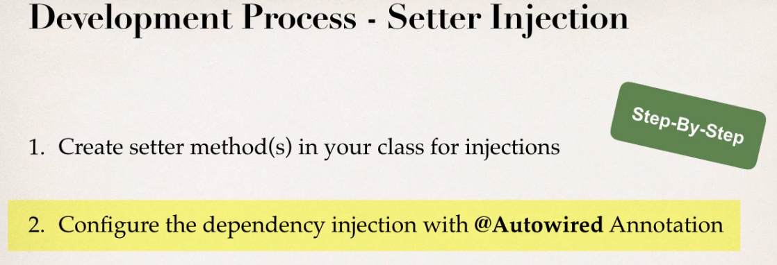
Setter Injection

Slide 9
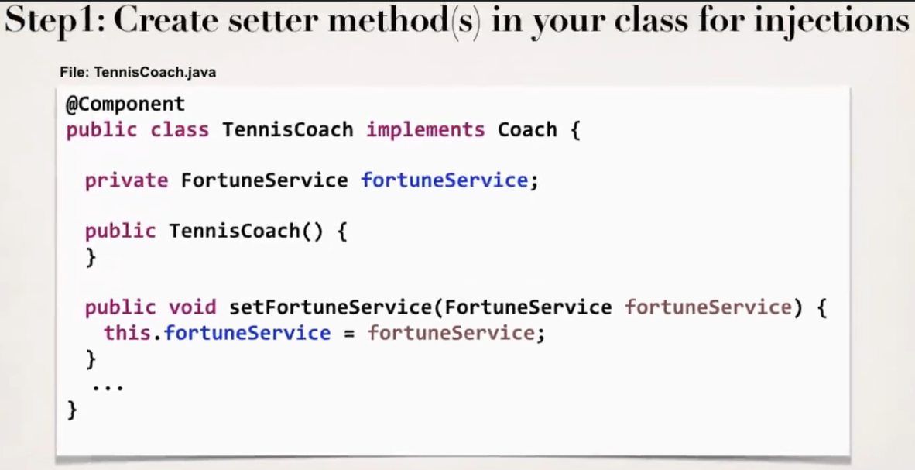
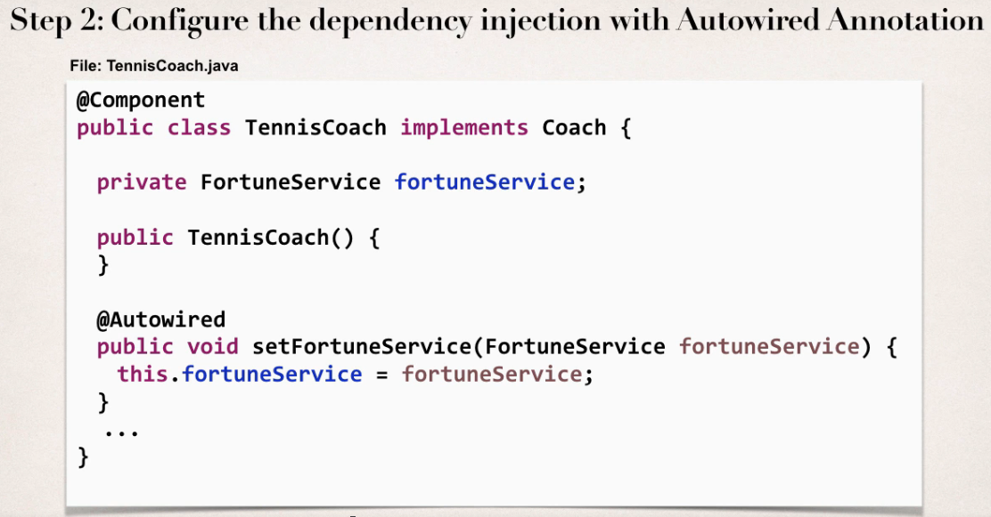
Notes:
We have commented the @AutoWired annotation in the left screenshot

Slide 10
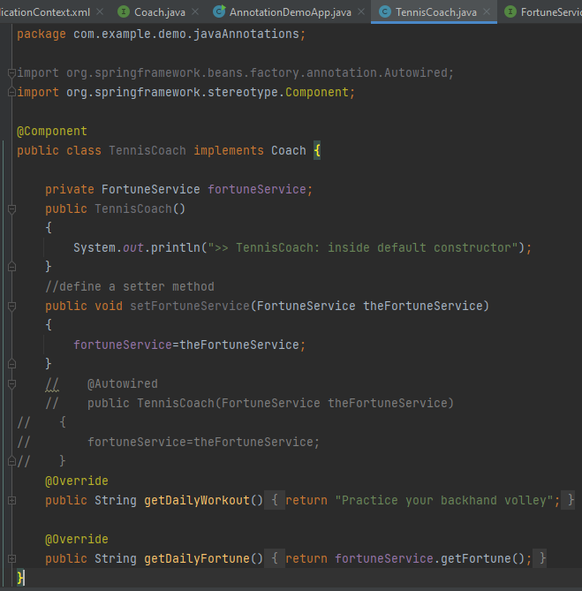
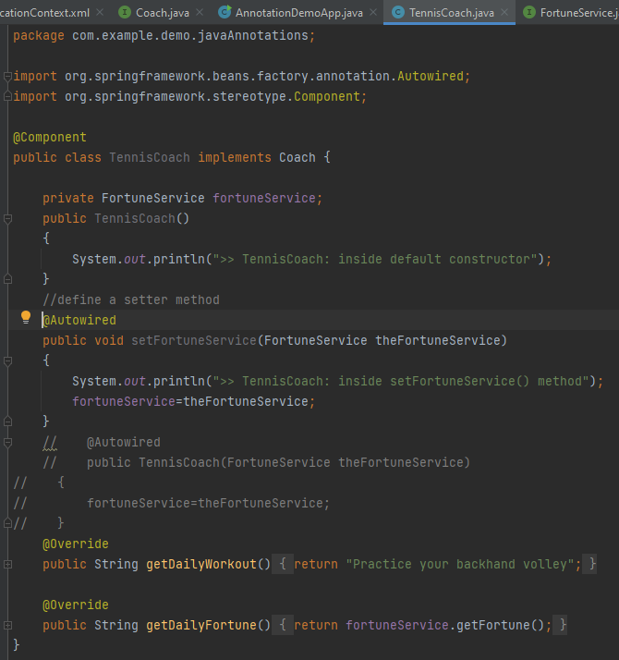
Step -1 Create setter method(s) in your class for injection
Step -2 Configure dependency injection with @Autowired annotation
Notes:
We have commented the @AutoWired annotation in the left screenshot as it was there for the constructor injection. In right screenshot we have given @Autowired with the setter method

Slide 11

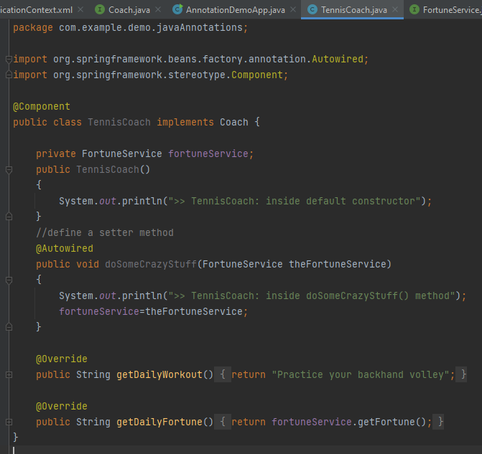
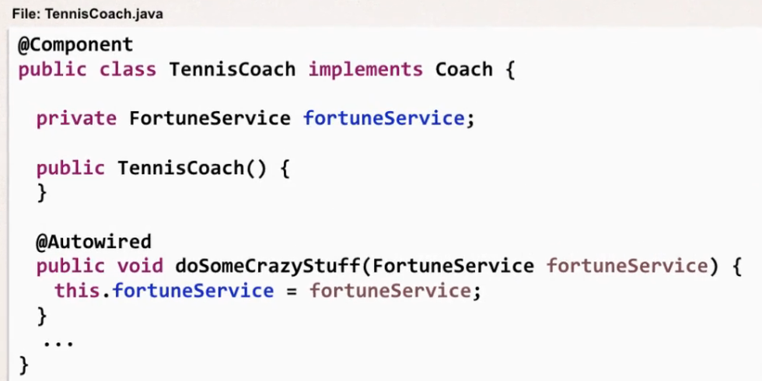
Notes:
We can use any method for dependency injection by using @AutoWired annotation

Slide 12
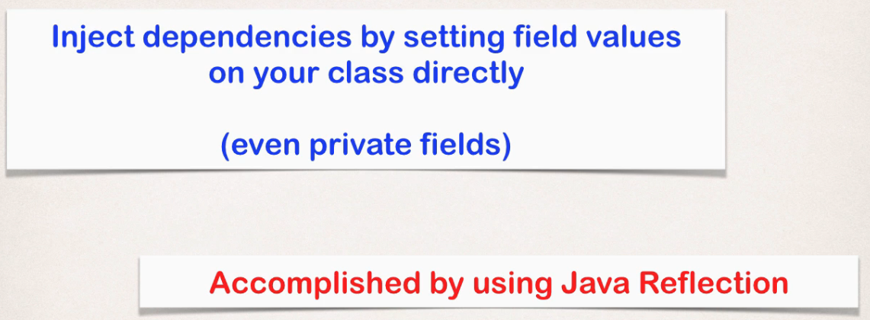

Field injection

Slide 13
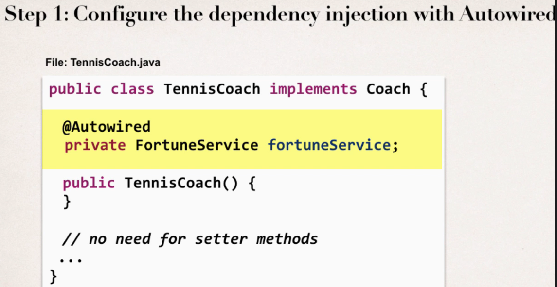
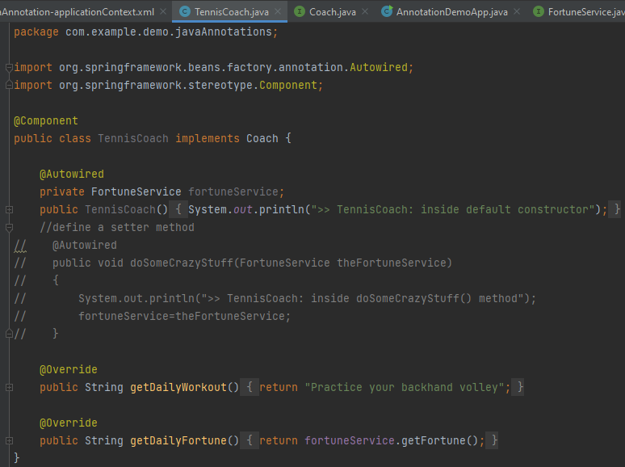
Notes:
This is the only step we need to implement field injection
There are so many injection, which injection should we use?
Answer(By Instructor) – Choose any one of them and stay consistent

Slide 14
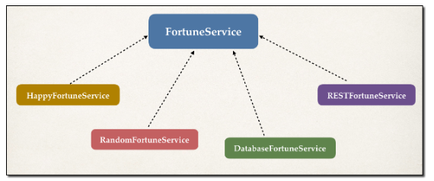
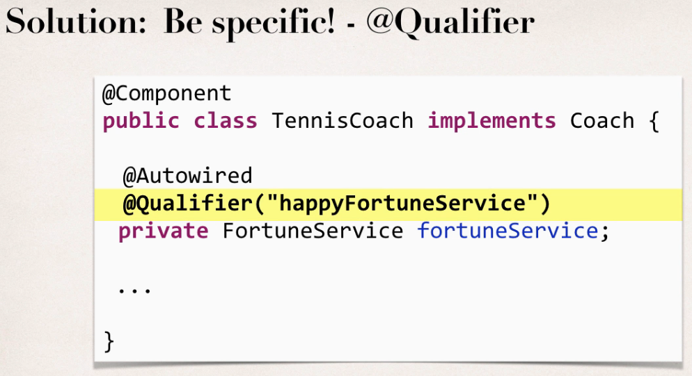
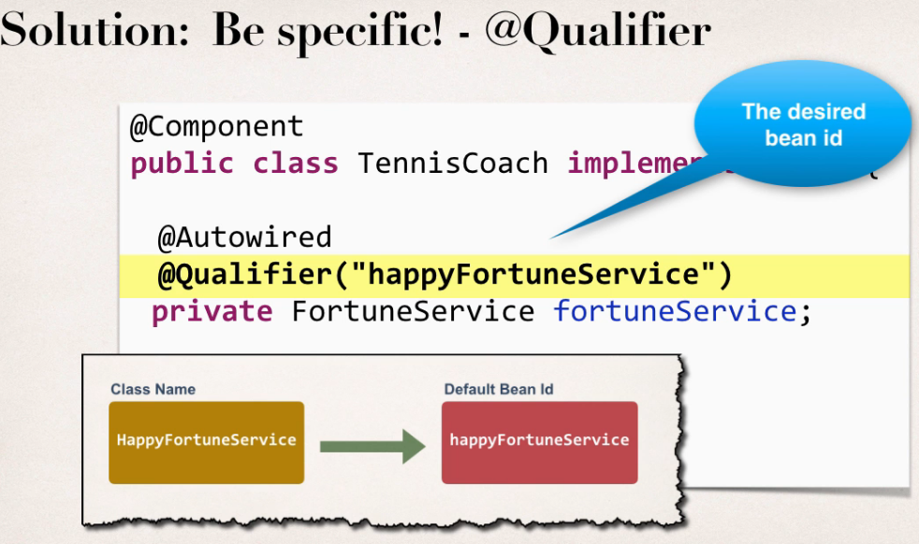
When using autowiring, what if there are multiple FortuneService implementations?
Spring has special support to handle this case. Use the @Qualifier annotation.

Slide 15
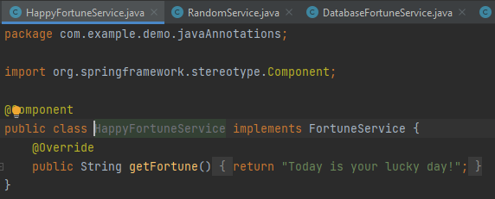
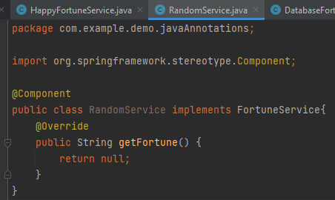
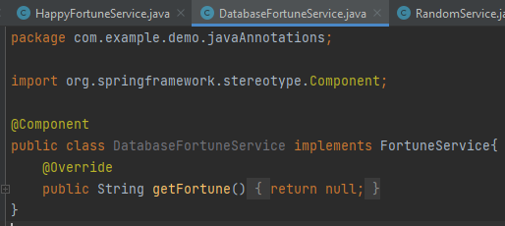
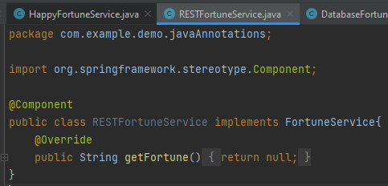
Notes:
In earlier implementations we have only one implementation of FortuneService i.e. HappyFortuneService but here we have implemented three more and we will get the error in this case.
Error will be - Caused by: org.springframework.beans.factory.NoUniqueBeanDefinitionException: No qualifying bean of type 'com.example.demo.javaAnnotations.FortuneService' available: expected single matching bean but found 4: databaseFortuneService,happyFortuneService,randomService,RESTFortuneService
So,we need to give qualifier

Slide 16
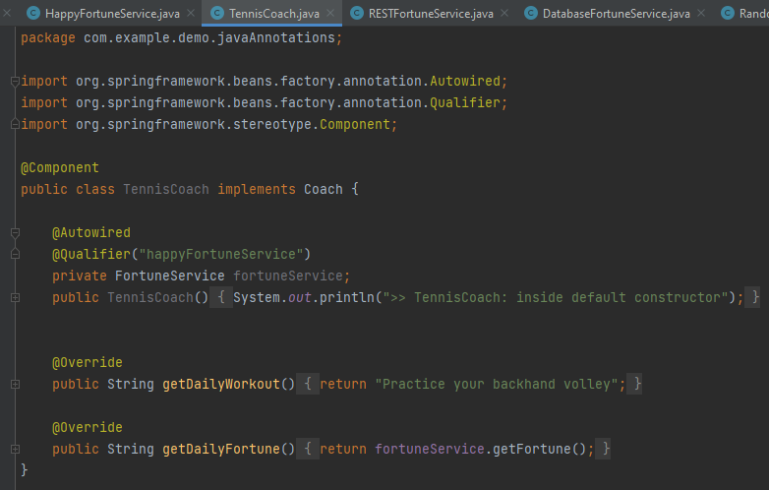
Solution - Using @AutoWired
Notes:
Here we have written bean id as happyFortuneService as by default it must start with small letter of class name .Class name - HappyFortuneService, bean id - happyFortuneService

Slide 17
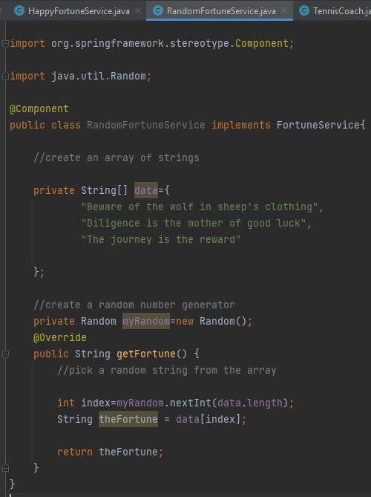
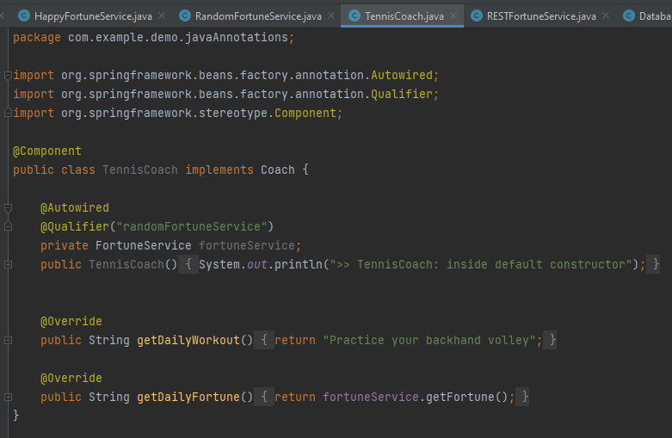
Trying with the RandomFortuneService
Notes:
Rest codes of the files will be same.We will get the random string as an output from the data array(left screen)
Annotations - Default Bean Names ... and the Special Case
In general, when using Annotations, for the default bean name, Spring uses the following rule.
If the annotation's value doesn't indicate a bean name, an appropriate name will be built based on the short name of the class (with the first letter lower-cased).
For example:
HappyFortuneService --> happyFortuneService
However, for the special case of when BOTH the first and second characters of the class name are upper case, then the name is NOT converted.
For the case of RESTFortuneService
RESTFortuneService --> RESTFortuneService
No conversion since the first two characters are upper case.
Behind the scenes, Spring uses the Java Beans Introspector to generate the default bean name. Here's a screenshot of the documentation for the key method.

Slide 18
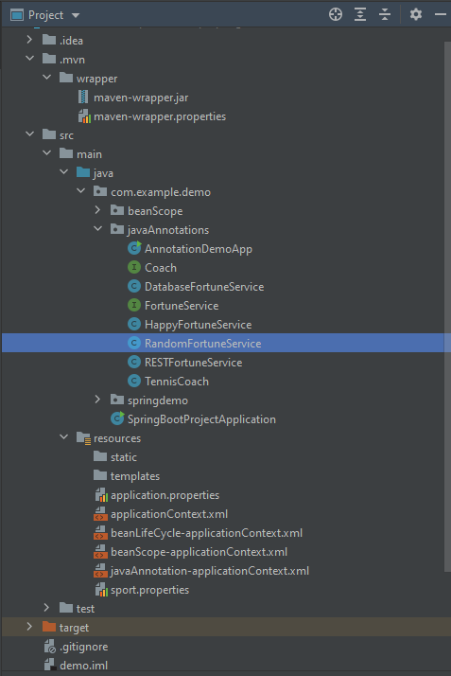
Final Project Structure
Notes:
Using @Qualifier with Constructors
@Qualifier is a nice feature, but it is tricky when used with Constructors.
The syntax is much different from other examples and not exactly intuitive. Consider this the "deep end of the pool" when it comes to Spring configuration LOL :-)
You have to place the @Qualifier annotation inside of the constructor arguments.
Here's an example from our classroom example. I updated it to make use of constructor injection, with @Autowired and @Qualifier. Make note of the code in bold below:
---
package com.luv2code.springdemo;
import org.springframework.beans.factory.annotation.Autowired;
import org.springframework.beans.factory.annotation.Qualifier;
import org.springframework.stereotype.Component;
@Component
public class TennisCoach implements Coach {
private FortuneService fortuneService;
// define a default constructor
public TennisCoach() {
System.out.println(">> TennisCoach: inside default constructor");
}
@Autowired
public TennisCoach(@Qualifier("randomFortuneService") FortuneService theFortuneService) {
System.out.println(">> TennisCoach: inside constructor using @autowired and @qualifier");
fortuneService = theFortuneService;
}
/*
@Autowired
public void doSomeCrazyStuff(FortuneService theFortuneService) {
System.out.println(">> TennisCoach: inside doSomeCrazyStuff() method");
fortuneService = theFortuneService;
}
*/
/*
@Autowired
public TennisCoach(FortuneService theFortuneService) {
fortuneService = theFortuneService;
}
*/
@Override
public String getDailyWorkout() {
return "Practice your backhand volley";
}
@Override
public String getDailyFortune() {
return fortuneService.getFortune();
}
}
---
For detailed documentation on using @Qualifier with Constructors, see this link in the Spring Reference Manual
https://docs.spring.io/spring/docs/current/spring-framework-reference/core.html#beans-autowired-annotation-qualifiers
====
@Qualifier with Setter Injection
You can use similar syntax with Setter Injection. You can use @Qualifier in method arguments line, such as
@Autowired
public void setFortuneService(@Qualifier("randomFortuneService") FortuneService theFortuneService) {
System.out.println(">> TennisCoach: inside setFortuneService() method");
this.fortuneService = theFortuneService;
}
You can also use the @Qualifier above the method name. For example, here's the syntax
@Autowired
@Qualifier("randomFortuneService")
public void setFortuneService(FortuneService theFortuneService) {
System.out.println(">> TennisCoach: inside setFortuneService() method");
this.fortuneService = theFortuneService;
}
Feel free to use the approach that works best for you.

Slide 19

Thank You
RAVI.PRAKASH2@FISERV.com

